Slide 1
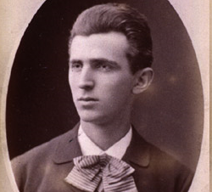
Nikola Tesla (1856-1943)
Short story about an inventor and his investors
“The Man who Lit the World”

Slide 2
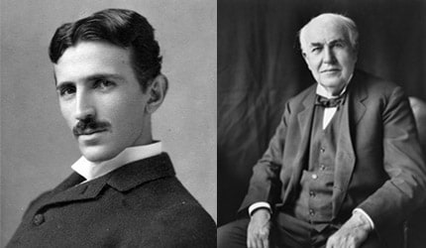
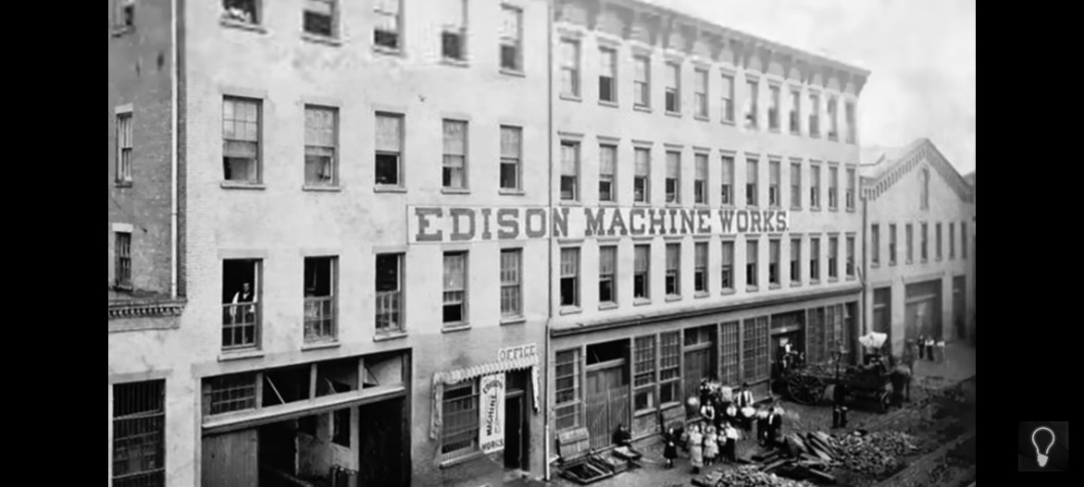
Tesla arrived at New York in 1884 and was hired as an engineer at Edison Machine Works.
He worked there for a year, solving Edison DC dynamos problems.
At one point Edison told Tesla he would pay $50,000 for an improved design for his DC dynamos.
Tesla solved all his dynamo problems.
But Edison cheated him by saying,
“Tesla, you don’t understand our American humor”
But Edison’s DC current had serious problems like it can’t be transmitted long distance.

Slide 3
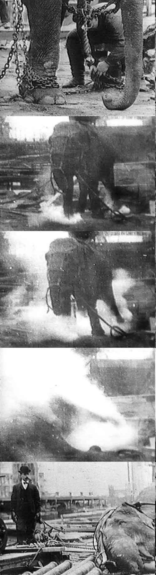
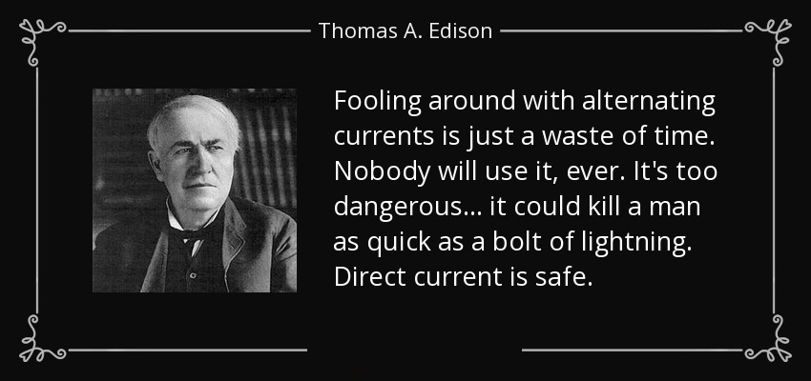
Tesla invented Alternating Current.

Slide 4
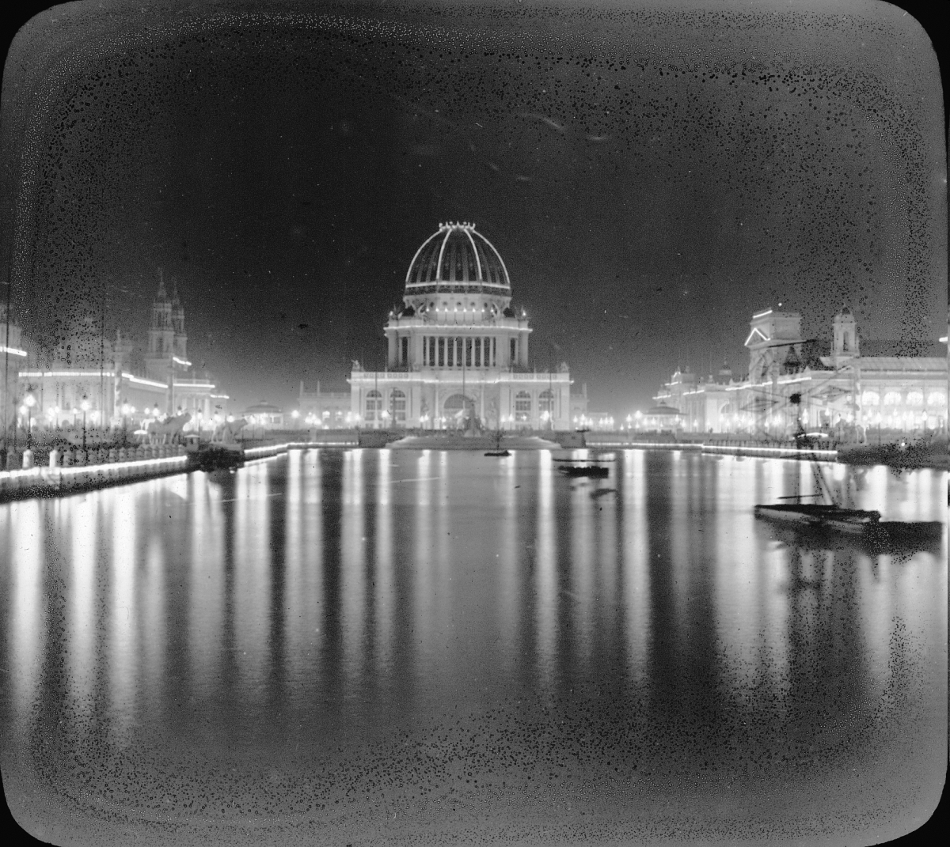
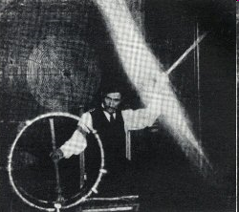
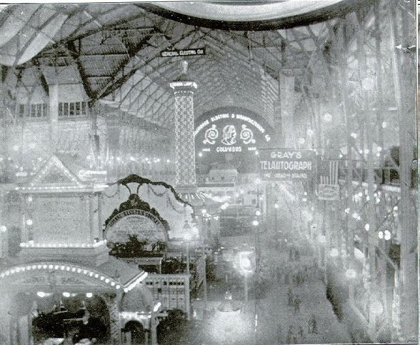
Westinghouse Ltd & Tesla proved it.
Building of Electricity
‘Court of Honor’ at the Columbian Exposition Chicago, 1893
Tesla passing high voltage through his body - 1898

Slide 5
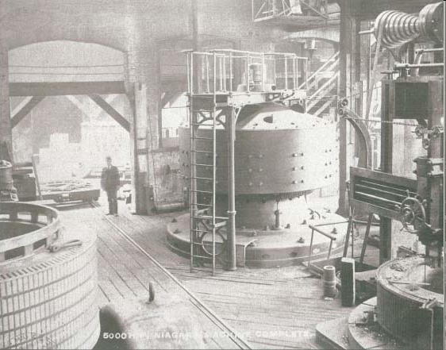
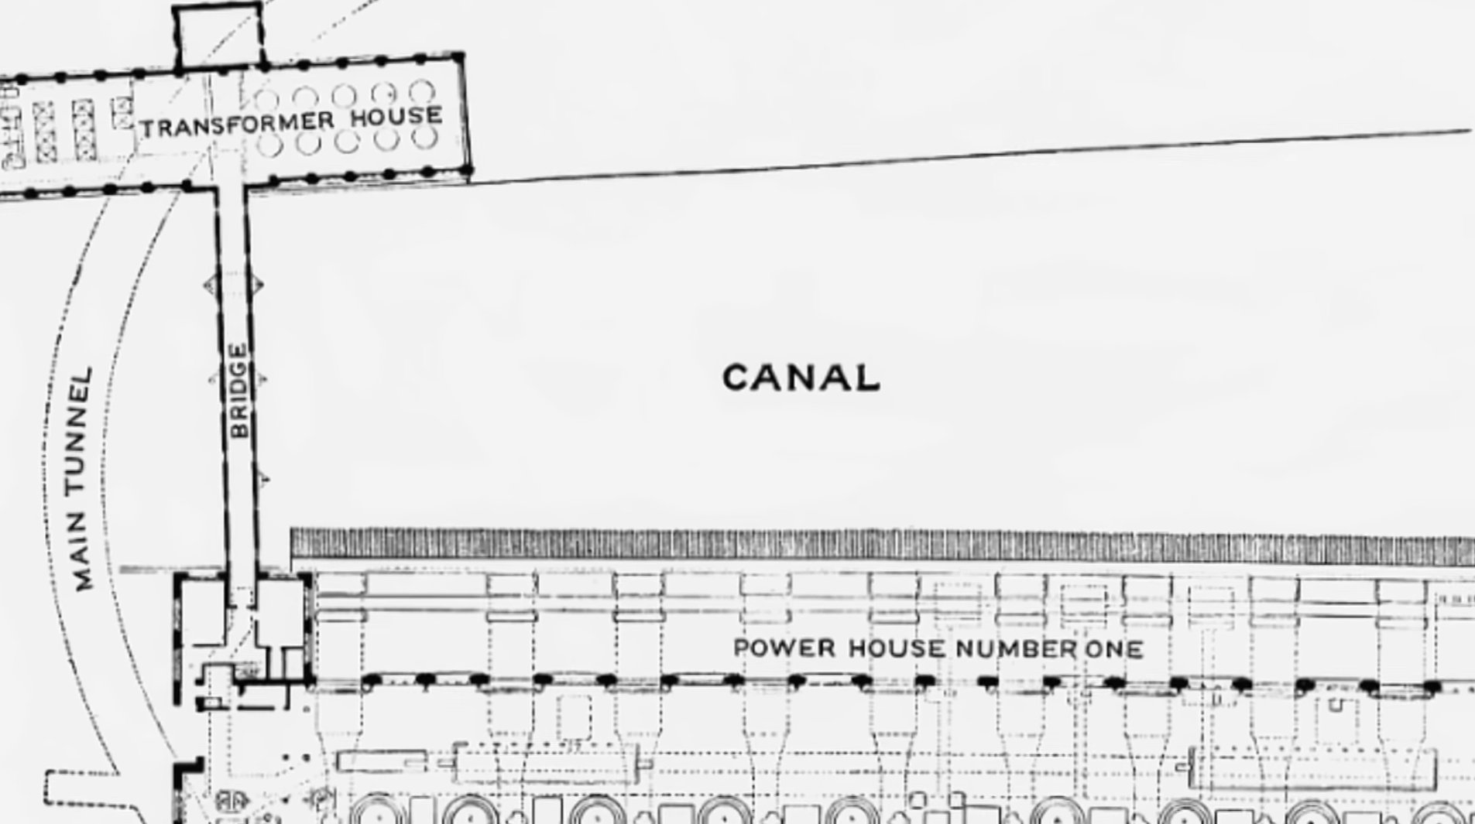
Finally, AC current was used by public as it had its advantage of far away transmission

Slide 6
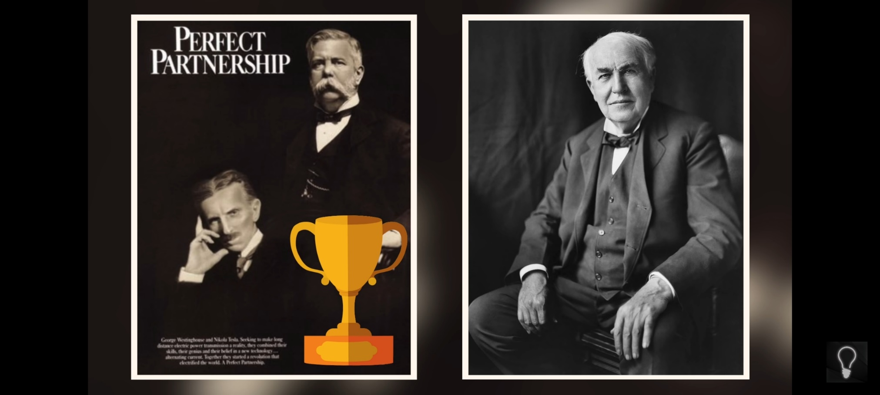
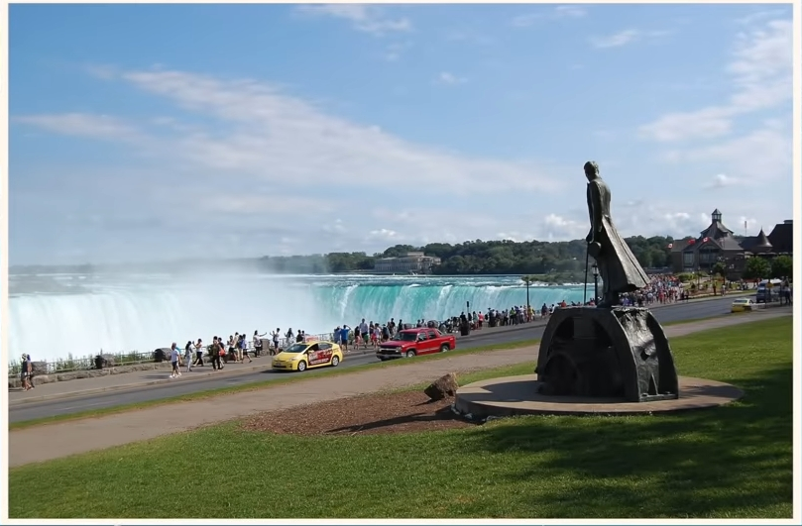

Slide 7
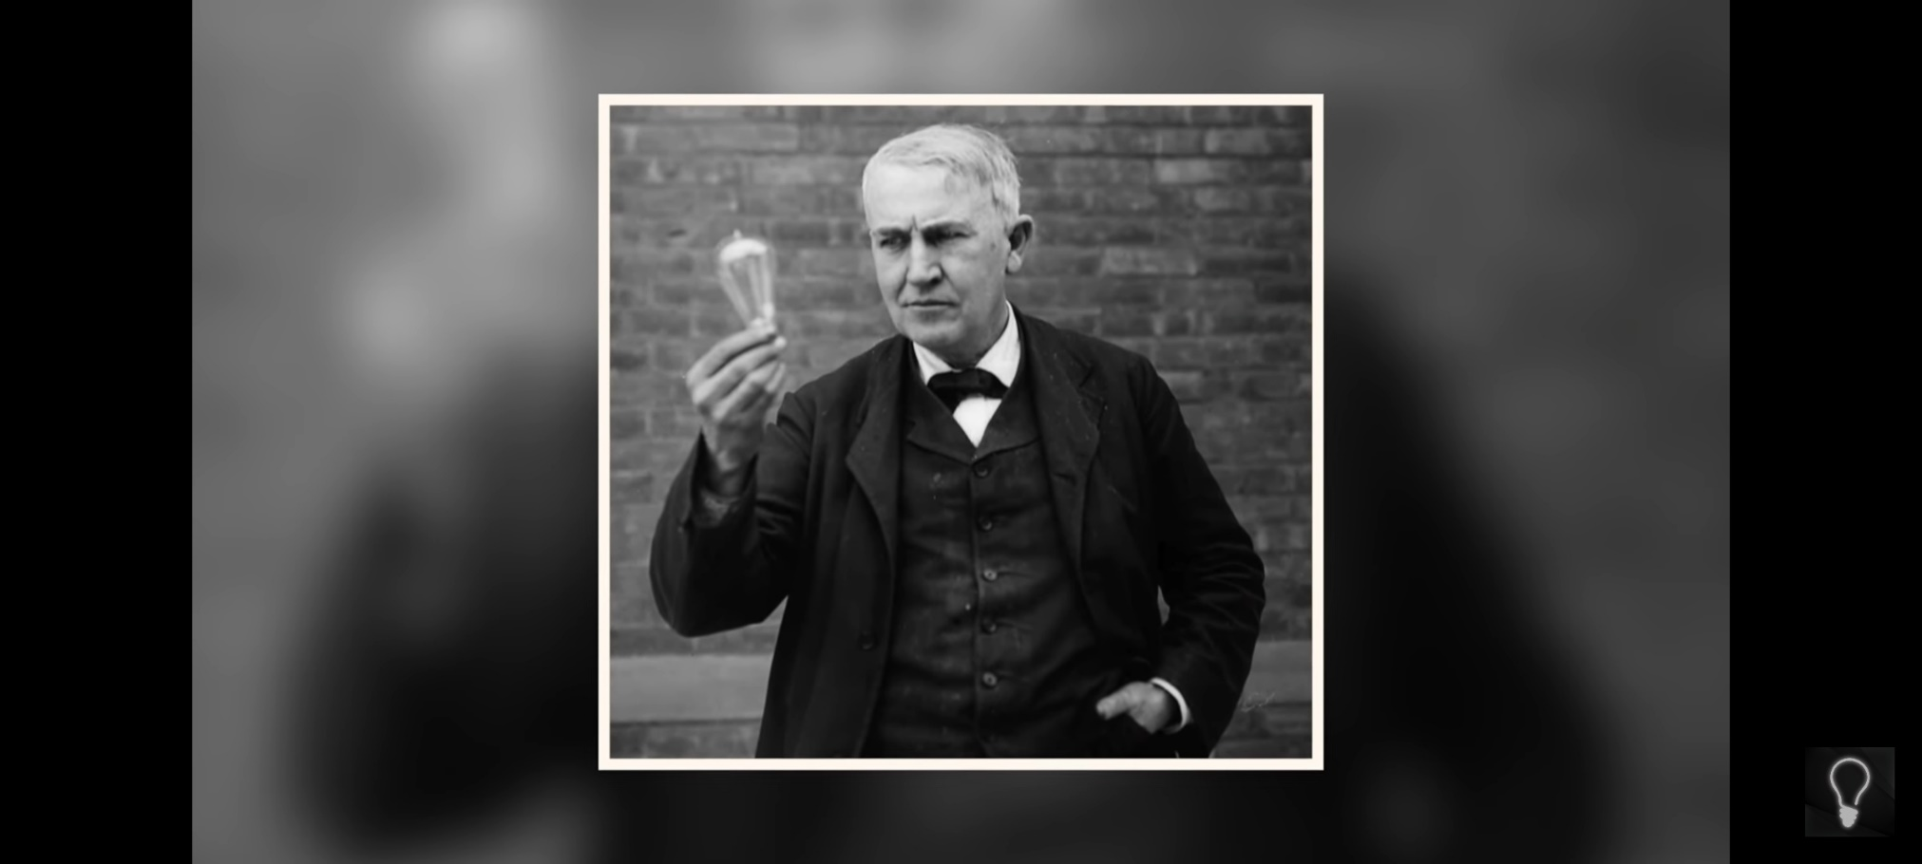
History always celebrated Edison and never spoke about Tesla.

Slide 8
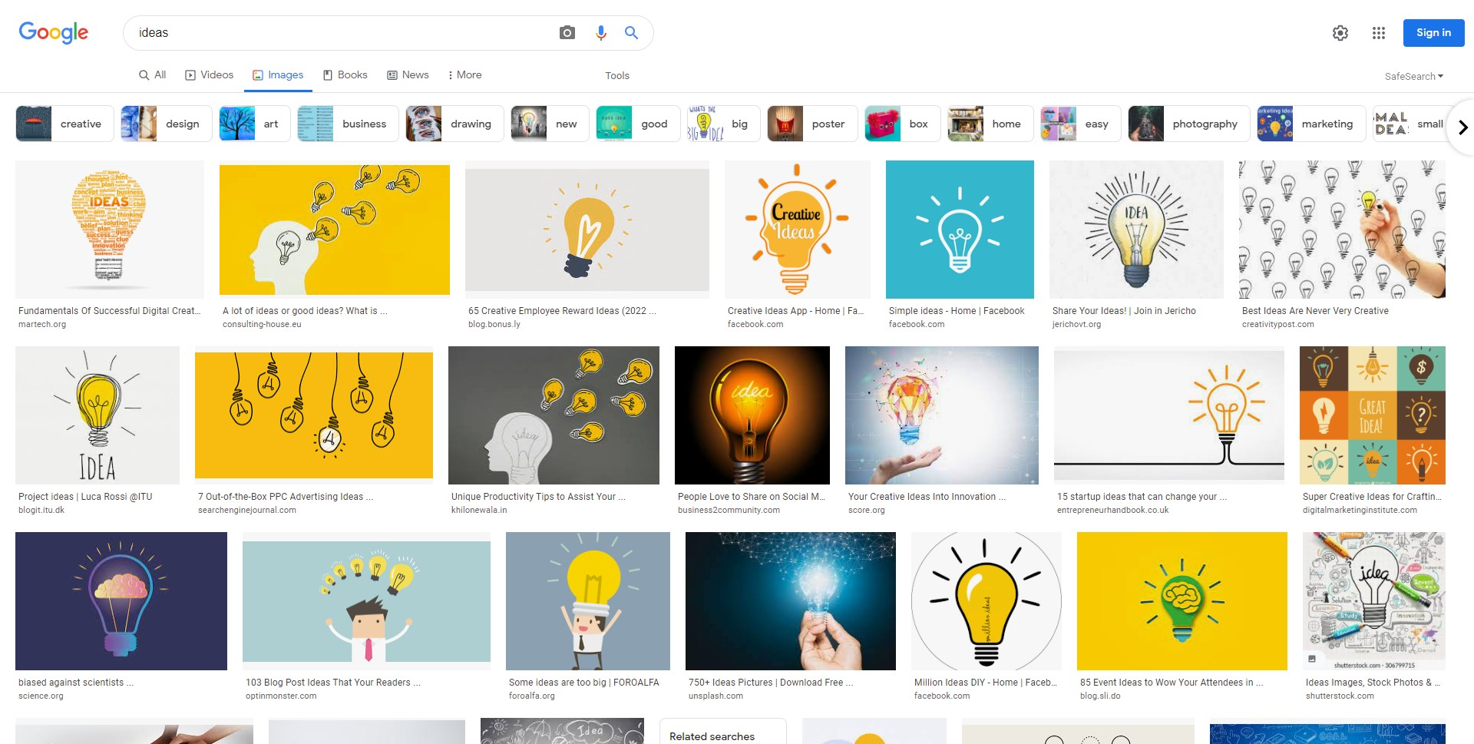
Idea – Why a bulb ?

Slide 9
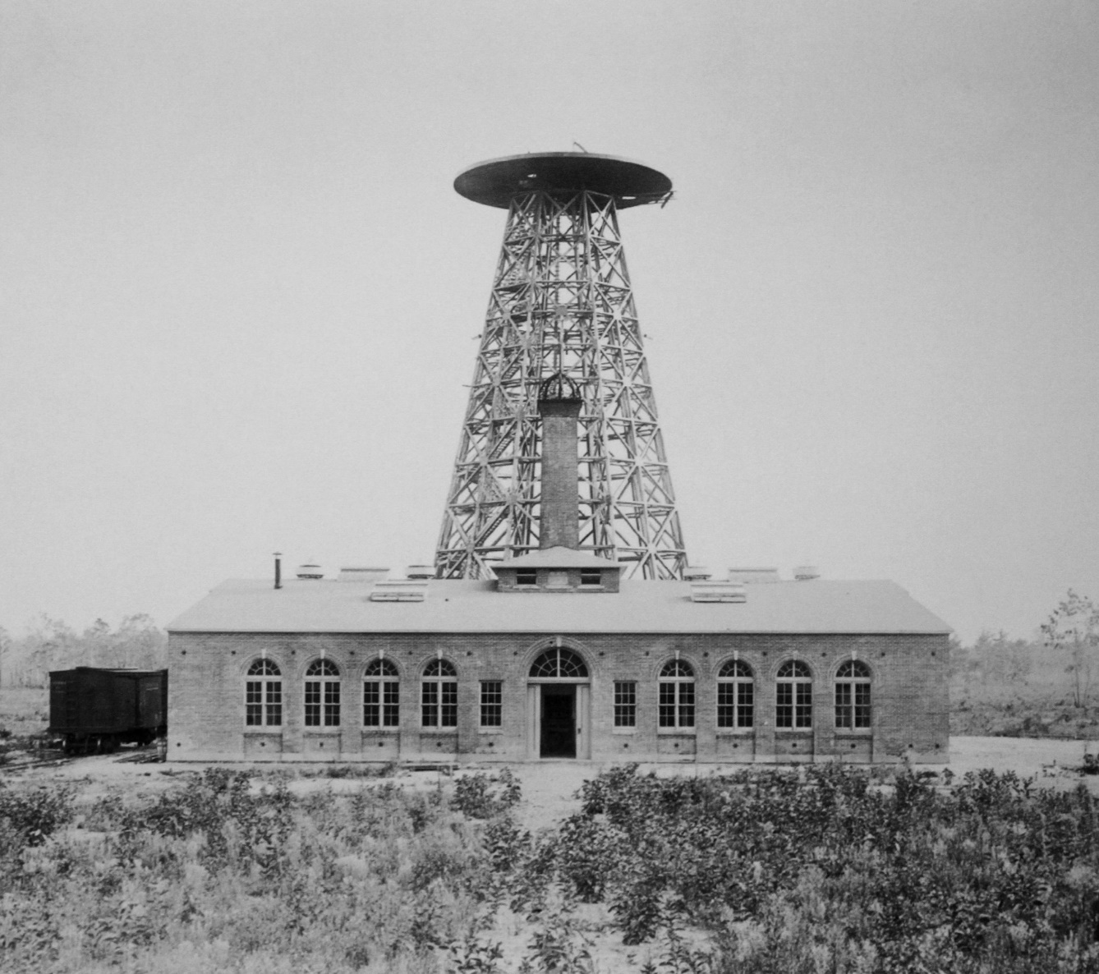
Here comes Tesla’s important invention which was shelved due to his new investor. The Wardenclyffe Tower

Slide 10
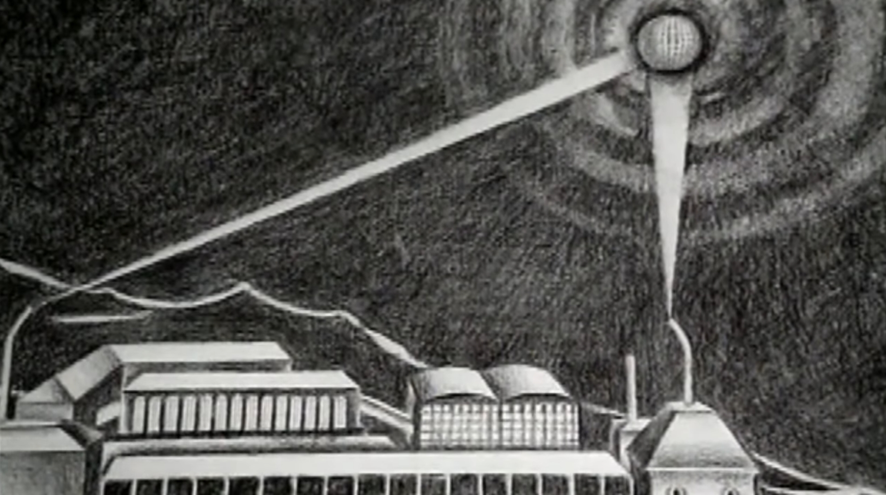
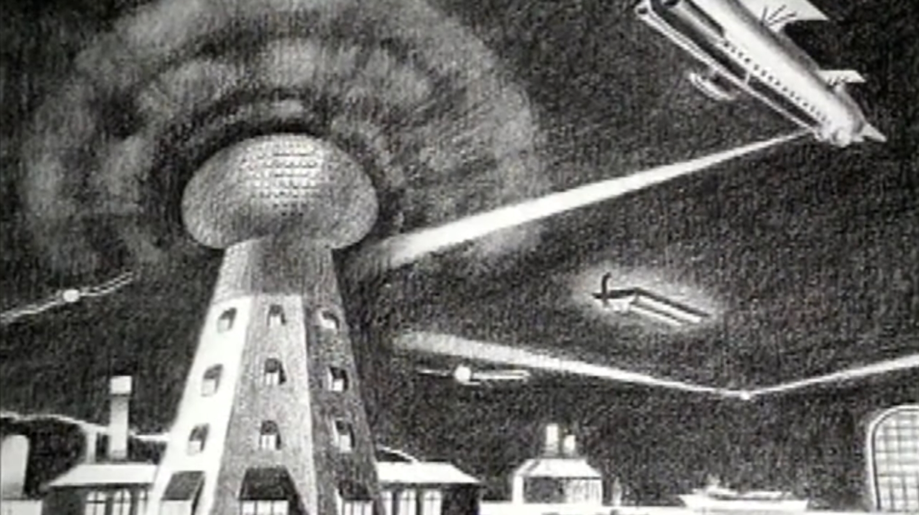
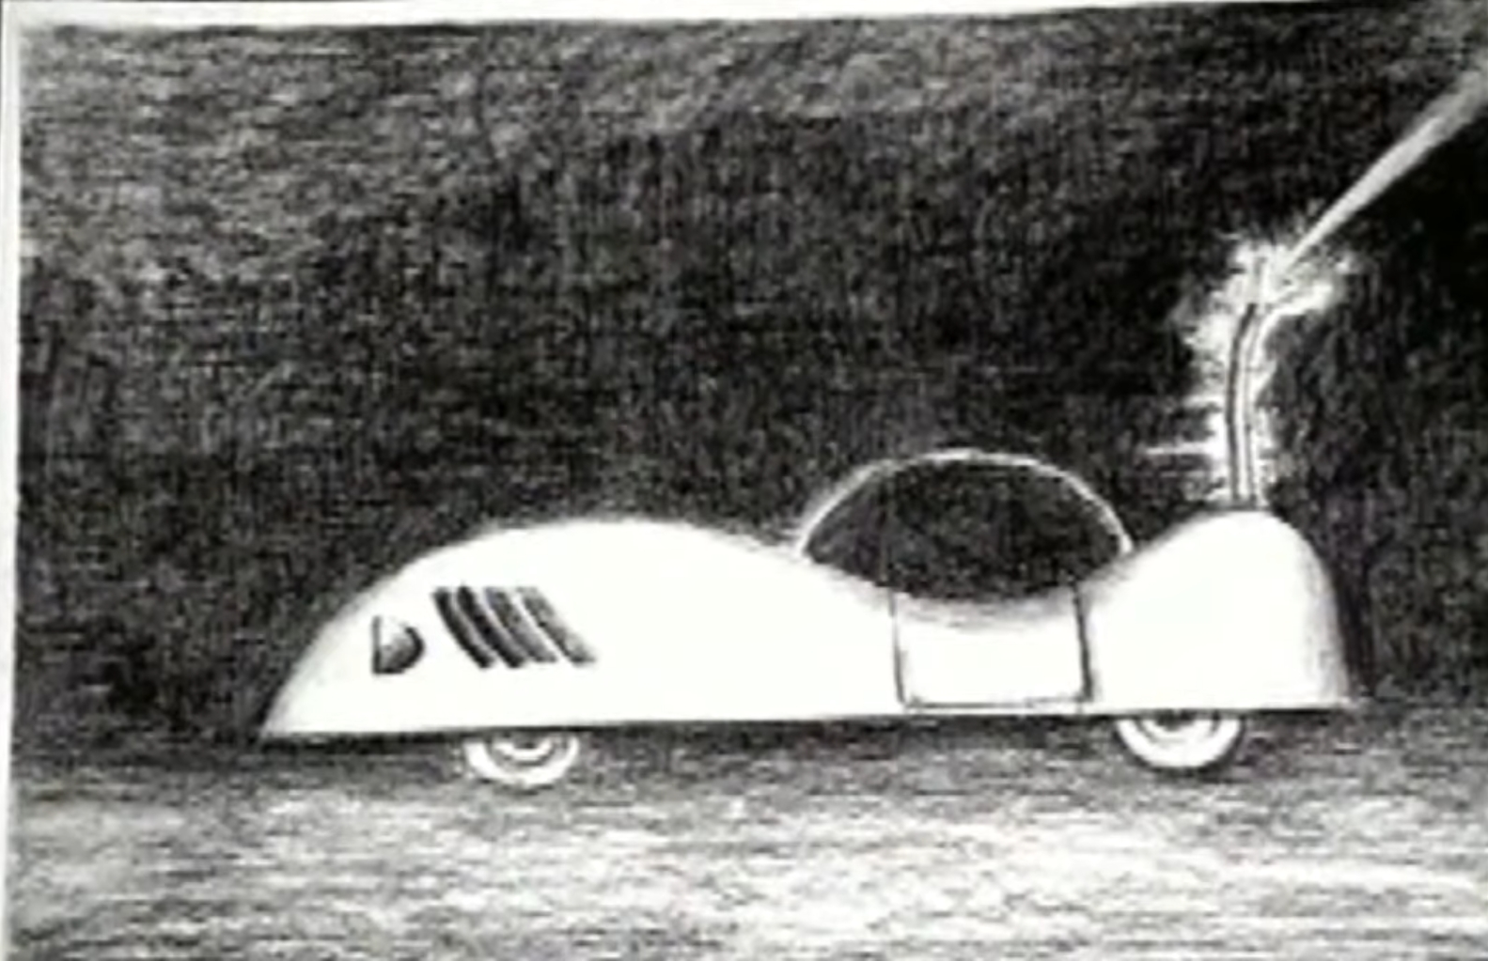
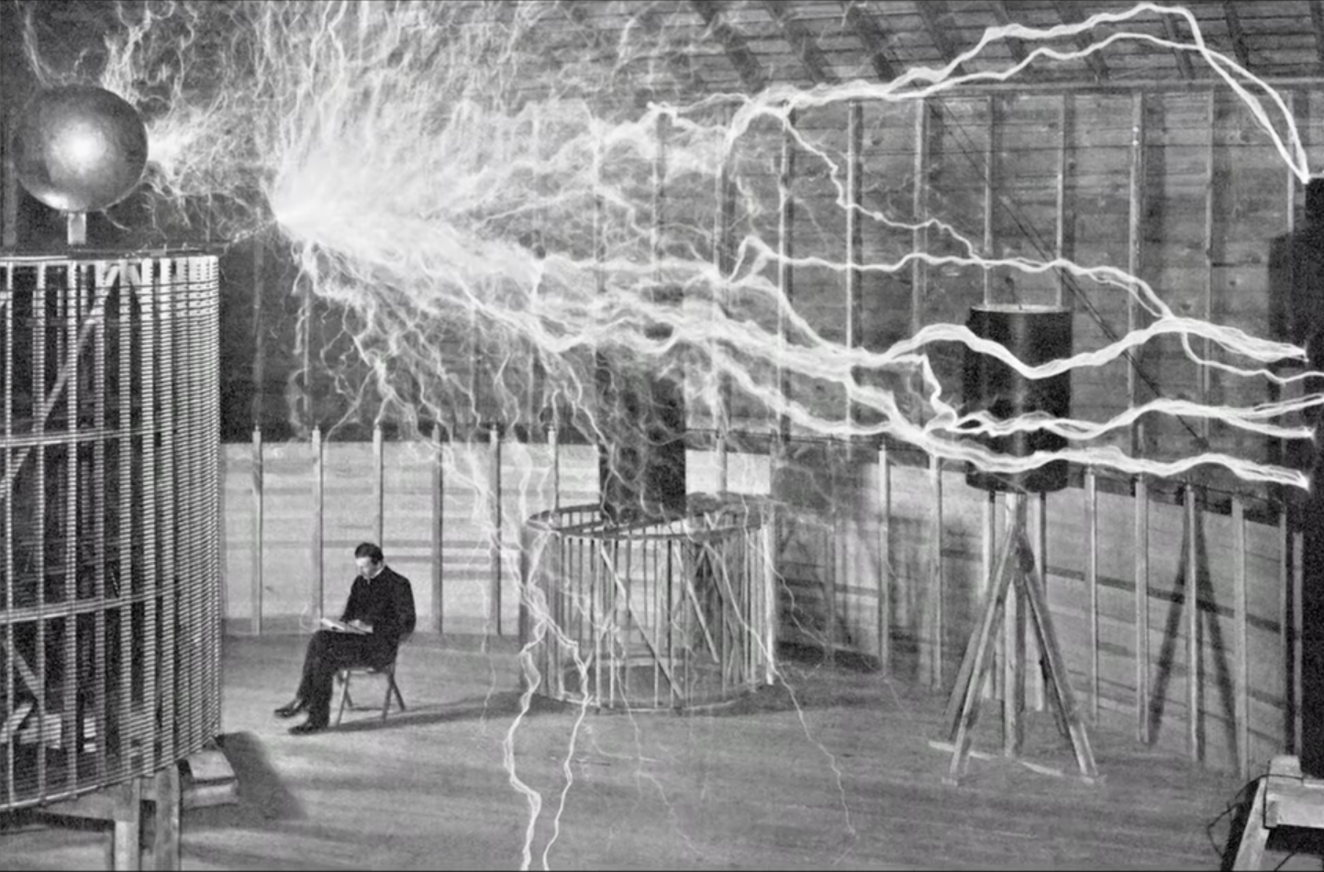
Tesla’s Ideas on Wireless Transmission
Three goals:
To develop a transmitter of great power
To perfect means for individualizing and isolating the energy transmitted (e.g., signals)
To establish the laws of propagation of currents through the earth and the atmosphere

